Slide 1



The main objective of
this project is to analyze
retail sales data to gain
actionable insights that
will enhance the
performance of the
Coffee Shop
Start Your Day With Coffee

Slide 2
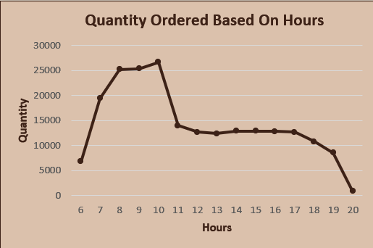
Recommended Analysis
1. How do sales vary by day of the week and hour of the day?
- Analysis shows that sales consistently increase during
the morning hours of each day.
2. Are there any peak times for salesactivity?
- Analysis shows that sales between 6 – 11 are higher than the other hour of the day.

Slide 3
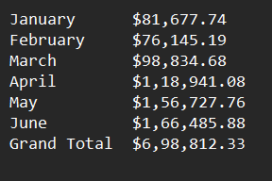
Recommended Analysis
3. What is the total sales revenue for each month?
Analysis shows that sales in
the Month of June is the highest.

Slide 4
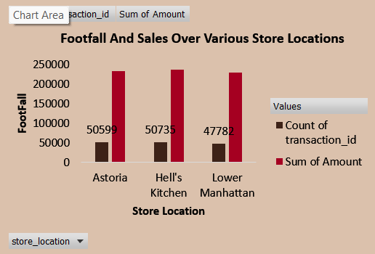
Recommended Analysis
4. How do sales vary across different sales
locations?
Analysis shows that Footfall In Hell’s Kitchen is the Highest
followed by Astoria and then Lower Manhattan.

Slide 5


Recommended Analysis
5. What is the Average Price per order per person?

Slide 6
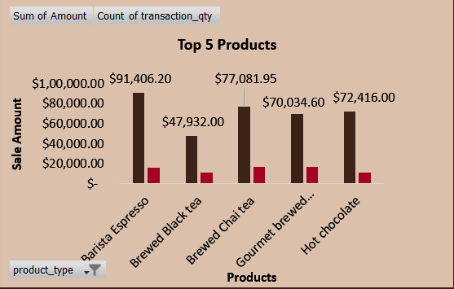
Recommended Analysis
6. Which Products are the best-selling in terms of
Quantity and Revenue?
In this analysis, we are looking at the top 5 products.
1. Barista Espresso
2. Brewed Black Tea
3. Brewed Chai Tea
4. Gourmet Brewed Coffee
5. Hot Chocolate

Slide 7
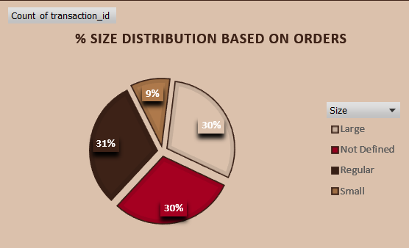
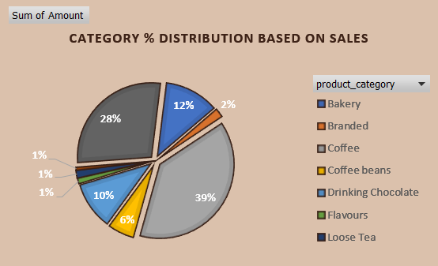
Recommended Analysis
7. How do sales vary by product category and type?
The analysis indicates that coffee and tea
are ordered significantly more
than other products,
with larger and
regular sizes being the
most popular choices.

